Slide 1
IPE Analysis
European Swallow Air-Speed Velocity, LLC
A subsidiary of Coconut Horseshoes

Slide 2
APT 38 Cyber Kill Chain Analysis

Slide 3
Terrain Analysis
Observability Assessment – Dual-Home Firewall DMZ, Guest access wireless network
Obstacles – KyleK 1.8 Dual-Homed Firewall, wireless access firewall, router ACLs
Concealment and Cover – DMZ, internal firewalls, honeypot
Avenues of Approach – DMZ through the internet, wireless access point

Slide 4
Threat Courses of Action
COA 1 – Use social engineering to gain access to internal network through malware dispersal using client executed installation of registry keys that grant access and allow for command and control of system to encrypt and/or delete data through ransomware.
COA 2- Use social engineering and/or port sniffing to gain access into the internal network through malware dispersal that allows persistent access to the network. Command and control through commonly used ports or web services to manipulate data that is not being detected.
COA 3 – Use honeypot port sniffing through CyberWilly or Cyber Danny RATs that allow the compromise to load cyberkitty memes by MeowWare.

Slide 5



Personnel
CEO & CFO
Access: All assets
Research and Development Staff
Access: R&D Network
HR and Sales Staff
Access: Operations Network
IT Staff
Access: Routers, firewalls, servers

Slide 6
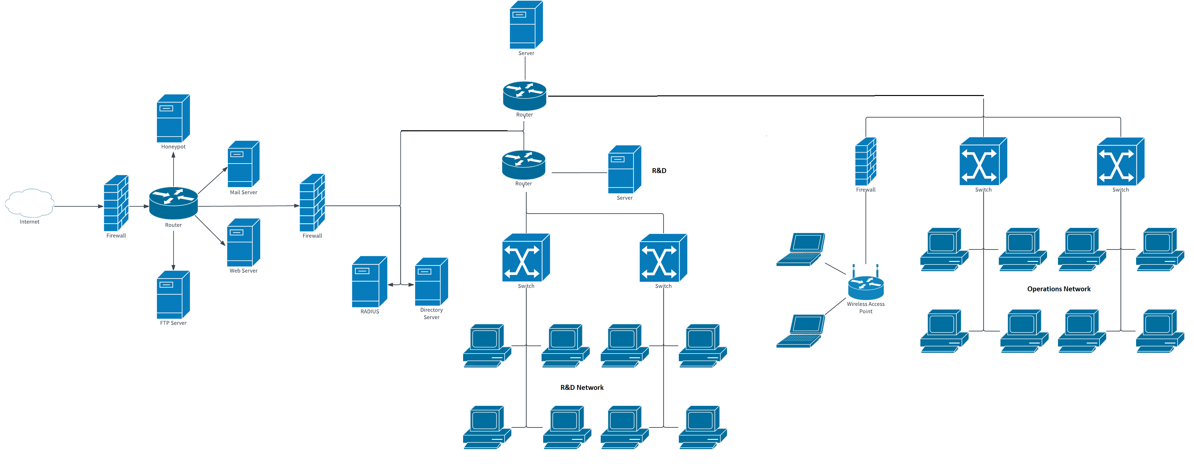
Network Diagram

Slide 7
Threat
CTI analysis suggest a highly capable APT is targeting the organization to steal technical information (intellectual property) on the software security products to:
Develop exploits and bypass the defenses.
Reproduce the products for sale.

Slide 8
COG Analysis
End State – Turn a profit
Ways – Turn research and engineering efforts into sales
Means – Scientists, Engineers, Resources, Sales, Marketing
COG – Sales and Marketing
Critical Requirements – Resources, Engineers
Vulnerabilities – Research & Development

Slide 9
Carver Matrix for CV Identification
VALUE | C | A | R | V | E | R | VALUE
5 | Loss would be a full company failure | Easily accessible | Extremely difficult to replace | Asset is highly vulnerable | Impact is highly dangerous | Asset is obvious | 5
4 | Significant Impact | Access controls | Significant | Very Vulnerable | Dangerous | Well documented | 4
3 | Normal Impact | Firewalls | Normal | Vulnerable | Serious | Visible | 3
2 | Minimal impact | Controlled enclaves | Minimal | Difficult to Exploit | Important | Obscure | 2
1 | No impact | Strong access controls | Easy to recover | Not Vulnerable | Low-impact | Complex | 1
Target | C | A | R | V | E | R | Total
R&D | 4 | 2 | 3 | 2 | 4 | 2 | 17
Operations | 4 | 2 | 3 | 4 | 2 | 5 | 20

